Slide 1
Fake news detection
Prepared by
Khushi Bhatt(210050131517)
Dhvani Doshi(200050131047)
Python for data science(3150713)

Slide 2
content
Abstract
Introduction
Required software
Conclusion

Slide 3
Abstract
Intentionally deceptive content presented under the guise of legitimate journalism is a worldwide information accuracy and integrity problem that affects opinion forming, decision making, and voting patterns. Most so-called 'fake news' is initially distributed over social media conduits like Facebook and Twitter and later finds its way onto main stream media platforms such as traditional television and radio news. The fake news stories that are initially seeded over social media platforms share key linguistic characteristics such as making excessive use of unsubstantiated hyperbole and non-attributed quoted content.
In this project , the results of a fake news identification study that documents the performance of a fake news classifier are presented.

Slide 4
Introduction
To build a model to accurately classify a piece of news as REAL or FAKE.
This minor python project of detecting fake news deals with fake and real news. Using sklearn, we build a TfidfVectorizer on our dataset. Then, we initialize a Passive Aggressive Classifier and fit the model. In the end, the accuracy score and the confusion matrix tell us how well our model fares.

Slide 5
Required software
Google Colab laboratory
Kaggle website used for dataset with fake and real csv files .
Reference from useful websites for coding language like greeks for geeks .

Slide 6




Python libraries We have used
Numpy
Pandas
Matplotlib
Sklearn

Slide 7
DataSet
The dataset we’ll use for this python project- we’ll call it news.csv. This dataset has a shape of 7796×4. The first column identifies the news, the second and third are the title and text, and the fourth column has labels denoting whether the news is REAL or FAKE .
We take dataset from below link of Kaggle website:
https://www.kaggle.com/code/yehorkorzh/fake-news-detection-96-accuracy/notebook

Slide 8
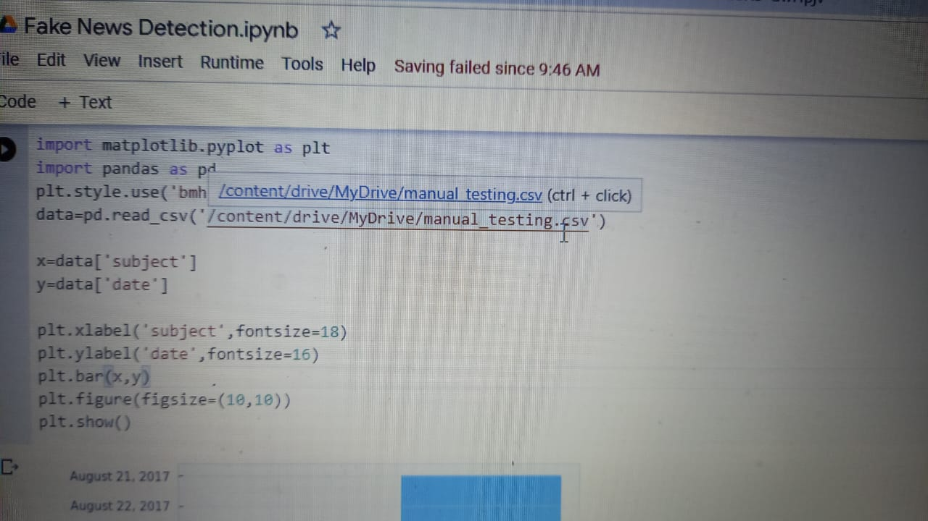
Plotting dataset by using Matplotlib

Slide 9
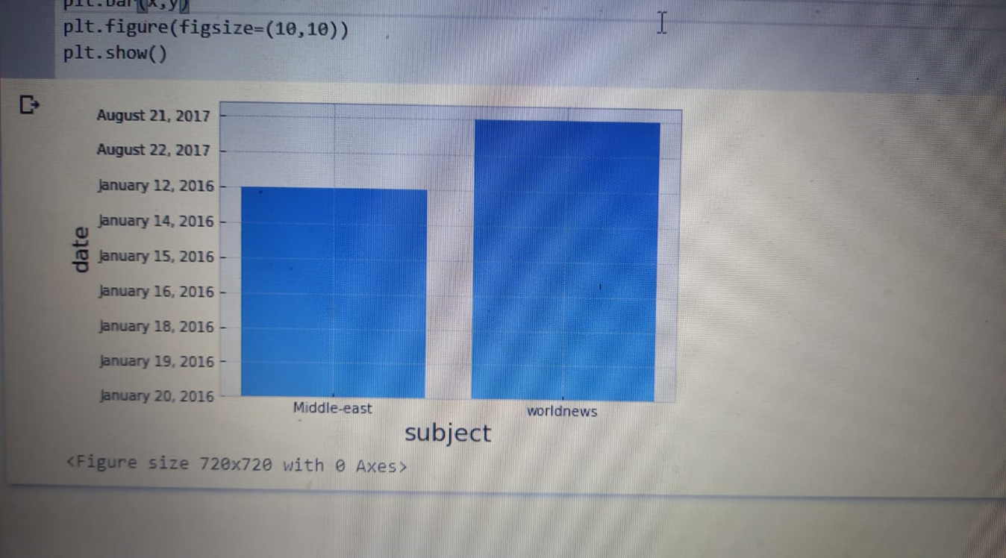
Bar graph

Slide 10
Conclusion
This project presented the results of a study that produced a limited fake news detection system. The work presented herein is novel in this topic domain in that it demonstrates the results of a full-spectrum research project that started with qualitative observations and resulted in a working quantitative model.
The work presented in this project is also promising, because it demonstrates a relatively effective level of machine learning classification for large fake news documents with only one extraction feature.
Finally, additional research and work to identify and build additional fake news classification grammars is ongoing and should yield a more refined classification scheme for both fake news and direct quotes.

